Slide 1

The Cigarette Consumption Panel
By Hope McCadden

Slide 2
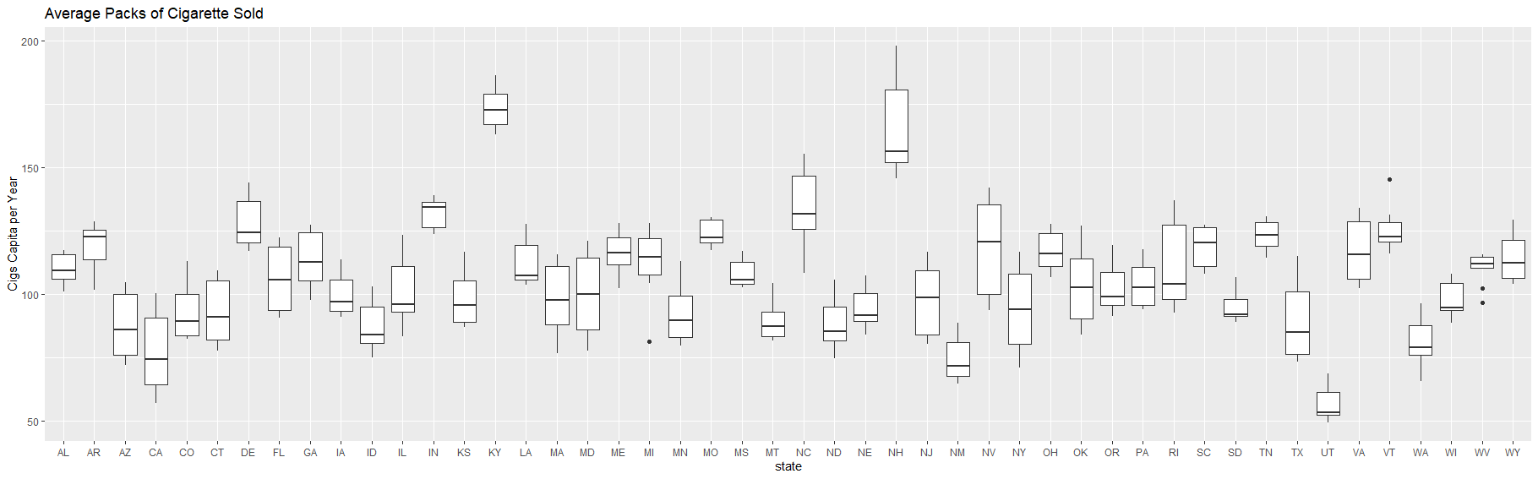
The Average Number of Packs Per Capita by State
Using geom_boxplot() to plot, which state has the lowest and highest number of packs of cigarettes sold between 1985 to 1995.
Using the summarise() to evaluate which states had the highest number of packs sold.
Utah is the with the lowest packs per capita and Kentucky is the highest state with packs per capita during that time.
According to the data provided, Utah sold an average of 56.8 packs of cigarettes per year.
Utah has strict laws on tobacco. The Utah Indoor Clean Air Act is a statewide ban that prohibits smoking in many public places. Also, being a western state and tobacco is normally harvest in states located in the south or southeast, which would affect the packs per capita rate.
Taking an educated guess, it is my opinion that fewer packs of cigarettes were sold in Utah since they do not harvest a large amount of tobacco, and due to that, the state prohibits public smoking in many places.
Kentucky had the highest number of packs sold during the time.
According to the data provided, Kentucky sold an average of 174 packs of cigarettes per year.
Kentucky is an east south-central state and its climate is favorable to harvest tobacco. Therefore, cigarette would be more plentiful and easily available for sale.
Taking an educated guess from the data provided, it is my opinion that people who resides in Kentucky has a much greater cancer diagnosis than people that resides in Utah.

Slide 3
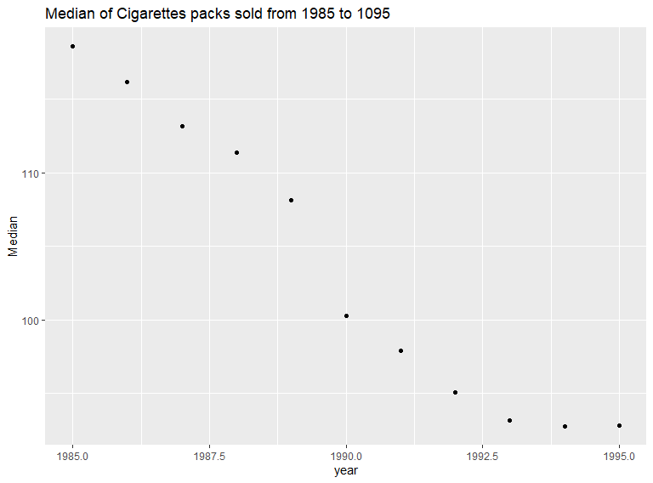
Median of packs sold for all states
According to the data provided, as the years increased the number of cigarettes sold decrease. Therefore, cigarettes usage declined.

Slide 4
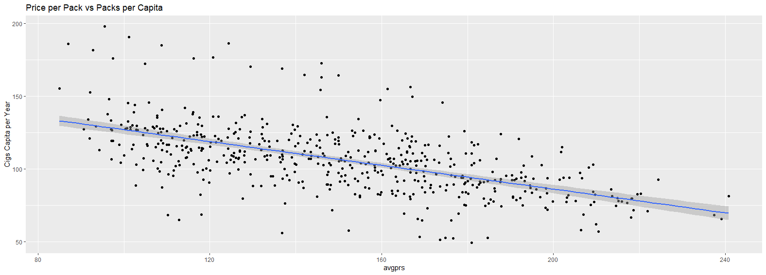
Price Per Pack vs Number of Packs Per Capita for all States & Years
The scatter plot reads from left to right; therefore the cigarette price and per capita packs are negatively correlated.
As the average number of packs sold per year decreases, the average cigarette price increased.
This is expected because fewer packs sold because of higher price
ggplot(Cigarette, aes(x = avgprs, y = packpc)) + geom_point() + geom_smooth(method = lm)+
ylab("Cigs Capita per Year") + ggtitle("Price per Pack vs Packs per Capita")

Slide 5
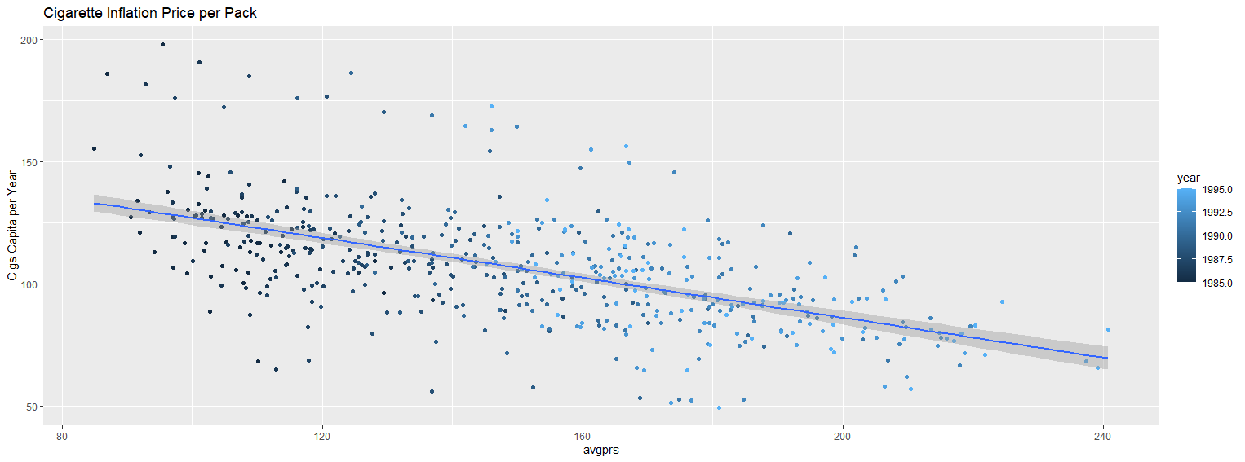
Cigarette Inflation per Pack
The relationship does change, the color is mostly lighter. So less cigarettes sold as the price increased.
ggplot(Cigarette, aes(x = avgprs, y = packpc, color = year)) + geom_point() + geom_smooth(method = lm)+
ylab("Cigs Capita per Year") + ggtitle("Price per Pack vs Packs per Capita")

Slide 6
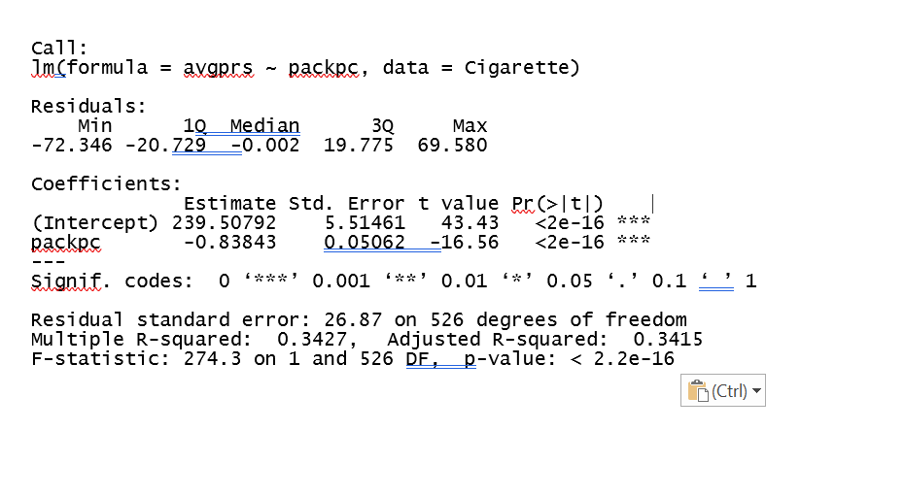
Linear Regression using Packpc and avgprs
There is 0.3415% of the variability between packpc and avgprs.

Slide 7
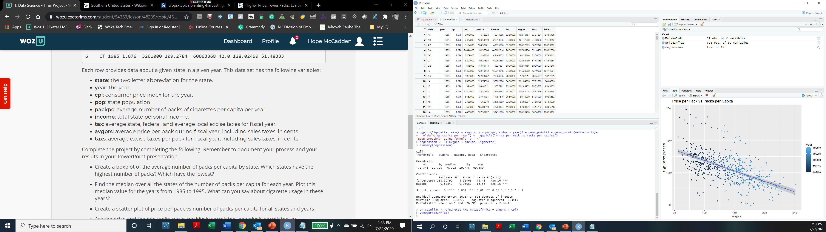
Calculating Inflation
Added a Price column to reference the inflation to priceInflat data frame.
The variability did not change when accounting for inflation. Variability remain at 0.3415% .
Inflat_Regression <- lm(avgprs ~ packpc, priceInflat)
summary(Inflat_Regression)

Slide 8
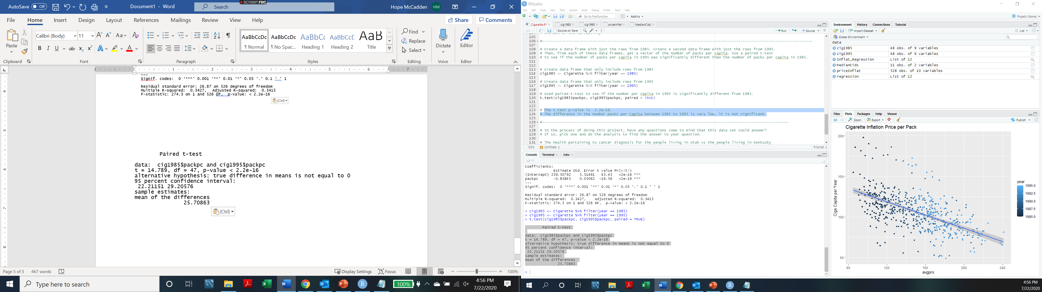
T - Test: Paired
Used paired t-test to see if the number per capita in 1995 is significantly different from 1985.
The t.test p-value is 2.2e-16.
The difference in the number packs per Capita between 1985 to 1995 is very low, it is not significant.
t.test(cig1985$packpc, cig1995$packpc, paired = TRUE)
t.test(cig1985$packpc, cig1995$packpc, paired = TRUE)
t.test(cig1985$packpc, cig1995$packpc, paired = TRUE)

Slide 9


Questions
The health pertaining to cancer diagnosis for the people living in Utah vs the people living in Kentucky?
According to the data provided, people who resides in Kentucky would have a much greater cancer diagnosis than people that resides in Utah.

